Slide 1
An Multi-level Clustering and Layer Based Guiding Network Routing Protocol for Underwater Wireless Sensor Networks
Presented by: Soustab Haldar (Roll: 21074029)
Under the guidance of Dr. Prasenjit Chanak
Department of Computer Science and Engineering, Indian Institute of Technology (BHU), Varanasi, Uttar Pradesh, INDIA - 221005

Slide 2
Introduction
Underwater Wireless Sensor Networks (UWSNs) are used for underwater information acquisition , marine survey and other purposes.
Components of UWSNs: Base Station(BS), Surface Sink Node(SSN), Ordinary Sensor Node(OSN).
OSNs have limited energy and battery replacement is not feasible – thus energy efficiency is key.

Slide 3
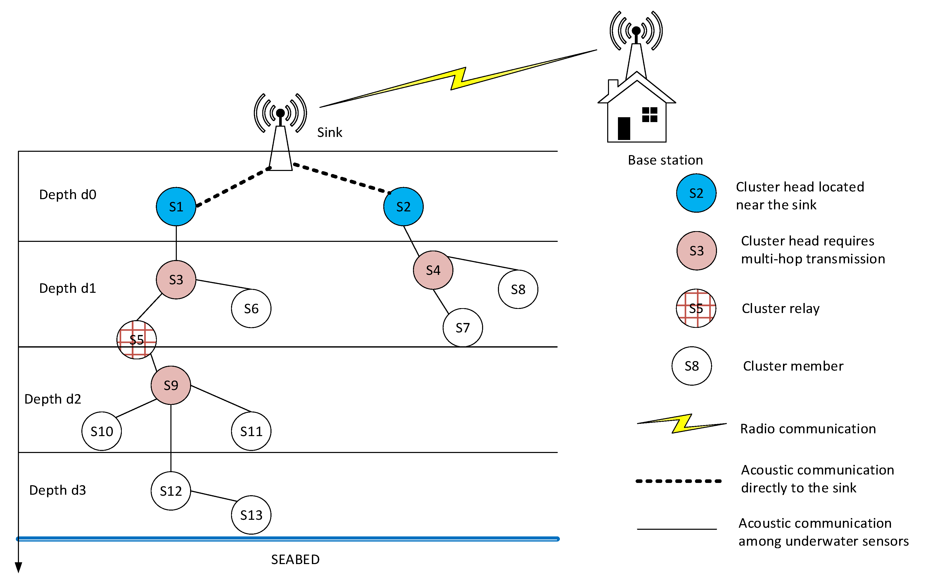

Slide 4
Routing Protocols for UWSNs
Localisation Based: Rely on the knowledge of the nodes' physical locations in the underwater environment – continuous location tracking is expensive.
Localisation Free: Operate without explicit knowledge of the nodes' physical locations – use signal strength or proximity based routing.
Co-operative Routing: Leverage collaboration among underwater sensor nodes. Energy-aware sensor networks and dynamic routing paths based on current network conditions.

Slide 5
Literature Review
Paper Title and Author | Methodology | Limitations
Depth-based Routing (DBR) Protocol Yan et. Al, International Conference on Research in Networking [1] | Based on depth information of nodes. DBR is a greedy algorithm -to deliver data packets to the water surface on the basis of depth difference. | DBR cannot find the eligible next-hop relay when a void region occurs.
Distance-vector based opportunistic routing (DVOR) protocol Guan et. al. IEEE Internet Things Journal 2021 [2] | Transfer data with the shortest path depending on depth distance-vector mechanism. Can handle void region problem. | They only use the single metric (the depth difference or the hop count) to determine the forwarding prioritization of relay candidates. The waiting mechanism used in them has to make a tradeoff between the network delay and the ability to suppress duplicate packets.

Slide 6
Paper Title and Author | Methodology | Limitations
Layer-based energy-efficient routing (LEER) Protocol J Zhu et. Al, International Conference on Ad Hoc Networks [3] | Forwarding prioritization was computed in terms of a composite metric - residual energy and the distances between the forwarding node and its relay candidates. | Packet delivery rate is average. CELR and other methods has better energy balance among the sensor nodes.
Connectivity and-energy-aware layering routing (CELR) Protocol Han et. al. IEEE Sensors Journal 2021 [4] | Single-route routing mode is considered in CELR to reduce the energy consumption in addition to DVOR mechanism. | The mobility of sensor nodes is not taken into account in CELR, and the selection of next-hop relay from relay candidates is sub-optimal.
Energy Efficient Clustering Routing Protocol based on Arithmetic Progression for Underwater Acoustic Sensor Networks (EECRAP) Khan et. Al, IEEE Sensors Journal 2024 [5] | Layer based division of simulation area, unequal cluster sizes and multi-hop transmission to SSNs. | Void handling is not discussed and due to each node having separate cluster sizes – network overhead during CH selection is large.

Slide 7
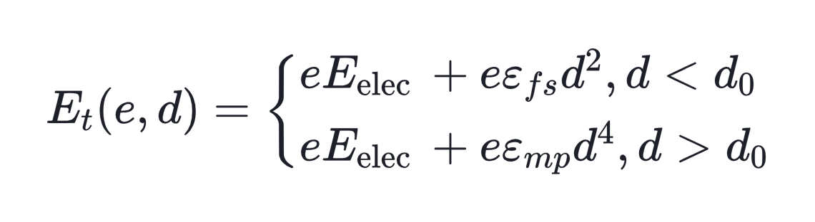
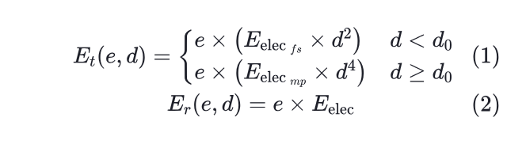
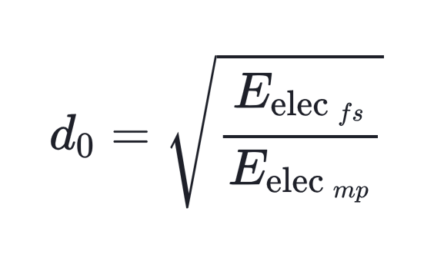

Multilevel Clustering and Layer Based Guiding Network Routing Protocol for Underwater Wireless Sensor Networks (MCLBGNR) [Proposed Model]:
Energy Model and Acoustic Propagation:
: energy consumed by a transmitter to transmit e bits of information,
: energy consumed by the receiver to receive the e bits of information.
: distance between receiver and transmitter
: number of bits
: per bit energy consumption of sensor circuit for transmission / receiving data
(3)

Slide 8
Multilevel Clustering and Layer Based Guiding Network Routing Protocol for Underwater Wireless Sensor Networks (MCLBGNR)
Network Architecture Layer and Sector Division Phase:
OSNs distributed randomly in the simulation space, SSNs are distributed in a pre-planned equi-spaced manner on the surface.
Underwater region is divided into layers with increasing width based on Arithmetic Progression(AP) – unequal layer widths to balance energy utilization.
Each layer further subdivided into equal sectors.

Slide 9
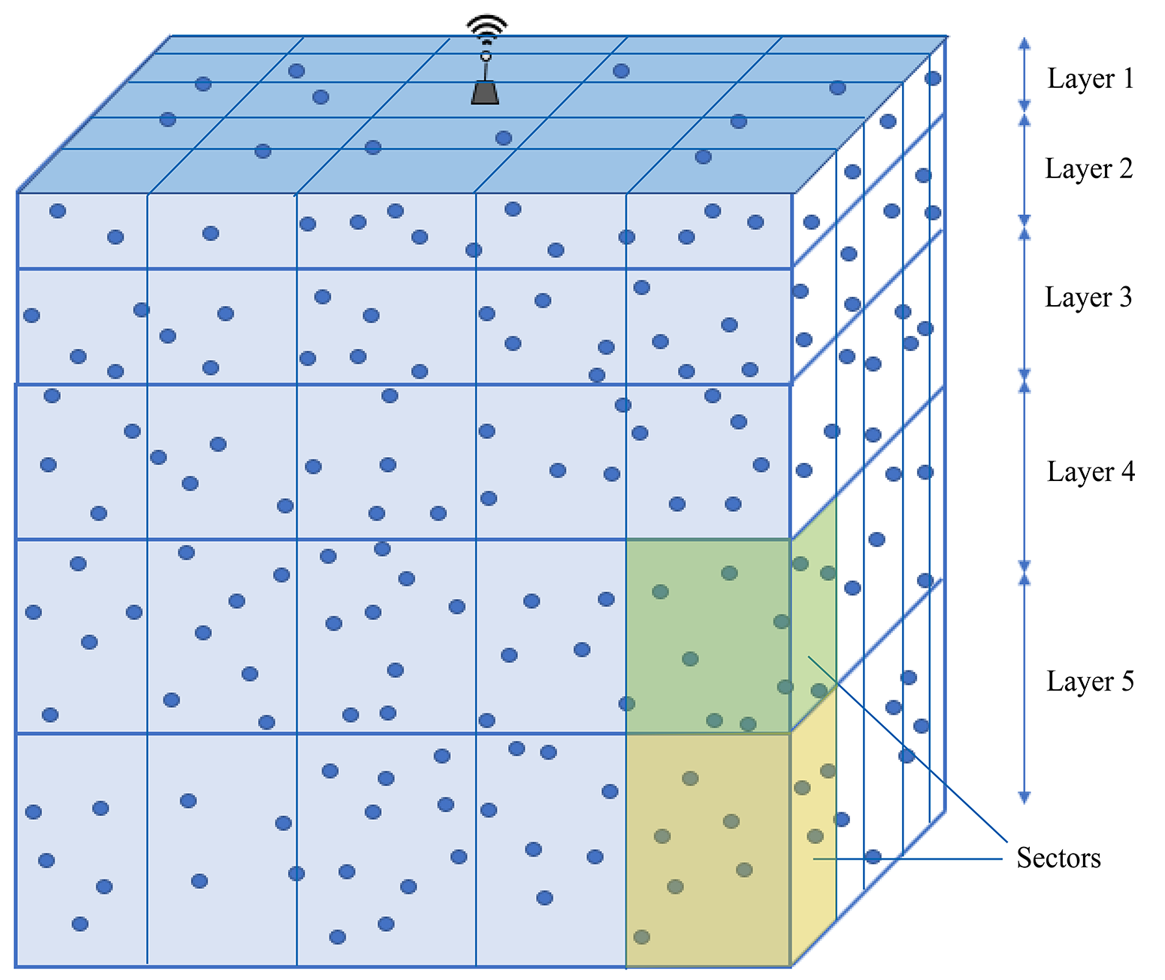

Multilevel Clustering and Layer Based Guiding Network Routing Protocol for Underwater Wireless Sensor Networks (MCLBGNR)
Network Architecture Layer and Sector Division Phase:
: width of nth layer
: width of first layer
: layer incremental constant
Fig: Layer and Sector based Division of UWSN

Slide 10
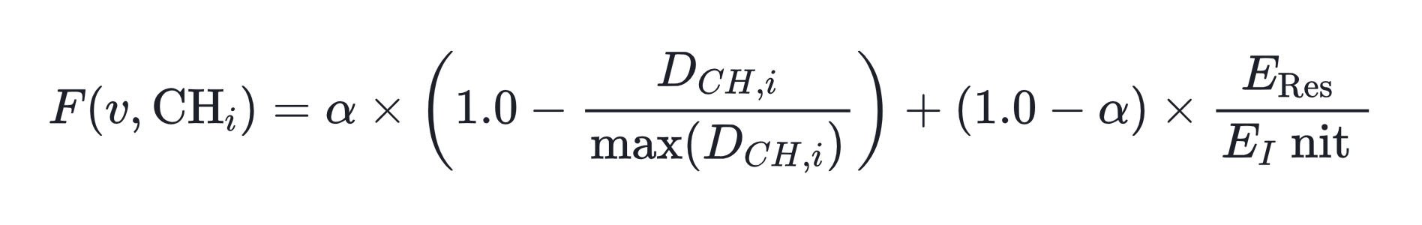
Multilevel Clustering and Layer Based Guiding Network Routing Protocol for Underwater Wireless Sensor Networks (MCLBGNR)
Sector-based Clustering Phase:
Each cluster is formed with nodes present within a sector.
Cluster Heads(CHs) are elected based on the node which has maximum Fitness Function:
CHs are re-elected when energy of a CH falls below threshold value.
: parameter (0 <= <=1)
: distance of node in a cluster from CH
: residual energy
: initial energy

Slide 11
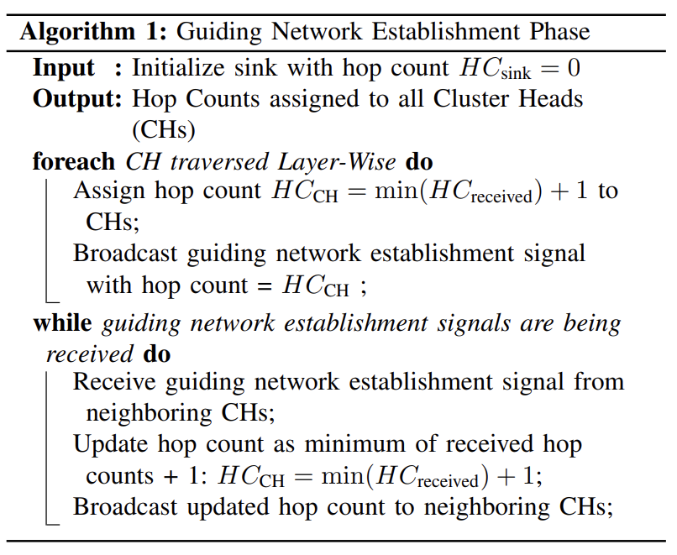
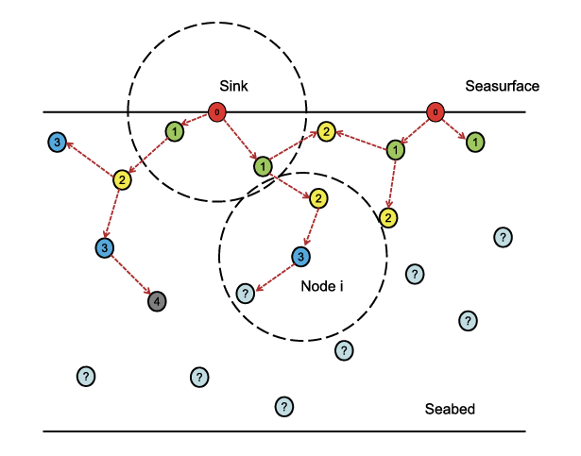
Multilevel Clustering and Layer Based Guiding Network Routing Protocol for Underwater Wireless Sensor Networks (MCLBGNR)
Guiding Network Establishment Phase:
All CHs are assigned a Hop Count (HC) by the Guiding Network originating from sink(s).
Fig: Guiding Network (for multi sink networks)

Slide 12
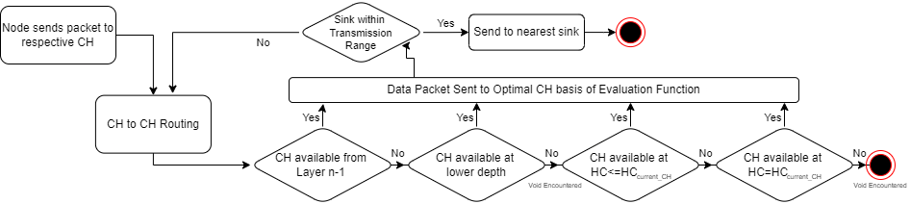
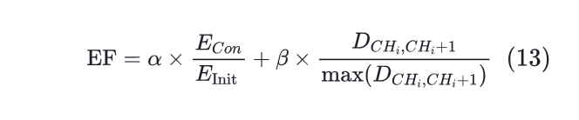
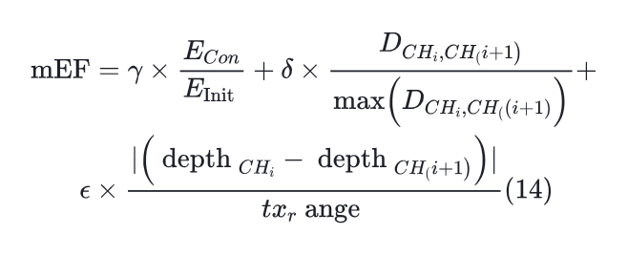
Multilevel Clustering and Layer Based Guiding Network Routing Protocol for Underwater Wireless Sensor Networks (MCLBGNR)
Routing Phase:
EF Function
EF Function
mEF Function
: Consumed Energy
: Initial Energy
: Distance b/w transmitting and receiving CHs
: Depth of CH
: parameters
: parameters

Slide 13
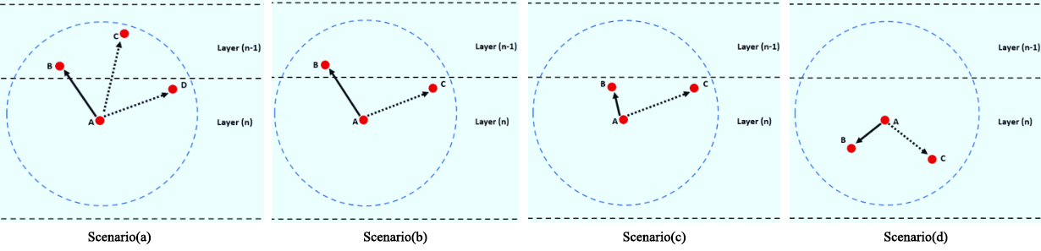
Multilevel Clustering and Layer Based Guiding Network Routing Protocol for Underwater Wireless Sensor Networks (MCLBGNR)
Routing Phase:
Scenario (a): If multiple CHs are available in layer n-1, most optimal CH is selected.
Scenario(b): Only 1 CH found in layer n-1, it is selected
Scenario (c): No CH in layer n-1 but multiple in layer n, most optimal CH is selected.
Scenario (d): Void Encountered.
Using mEF, most optimal relay CH is selected, if none found packet sent back to parent.

Slide 14
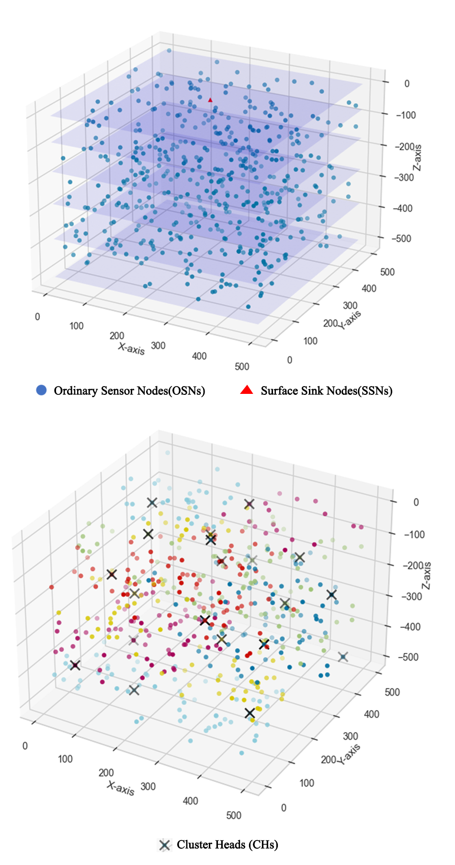
UWSN Network Structure
Fig: UWSN Network Structure with Layer Division and CHs

Slide 15
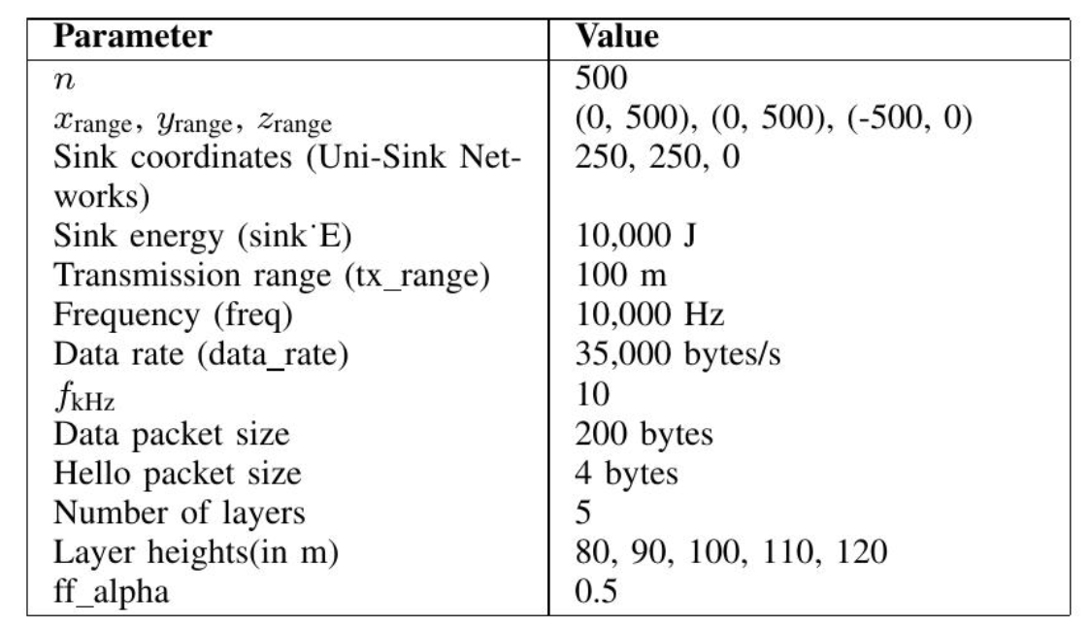
Performance Evaluation

Slide 16
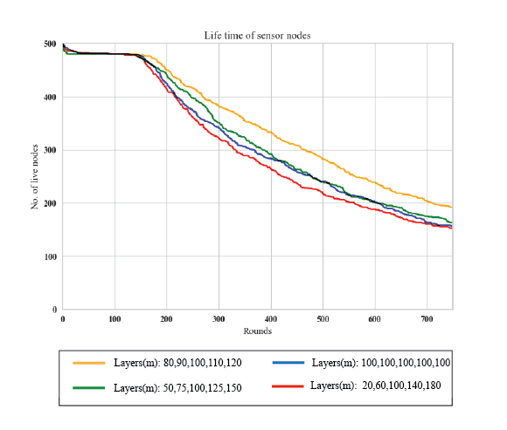
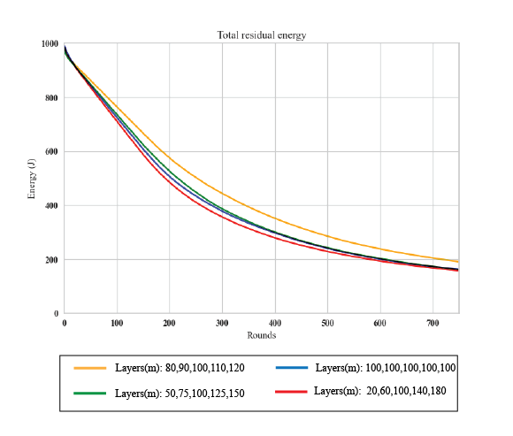
Performance Evaluation
Layer Division (in m) | Number of Dead Nodes | Residual Energy (in J)
Layer: 50,75,100,125,150 | 344 | 186.4181698
Layer: 80,90,100,110,120 | 309 | 190.4183241
Layer: 100,100,100,100,100 | 337 | 160.8147638
Layer: 20,60,100,140,180 | 349 | 157.0430254

Slide 17
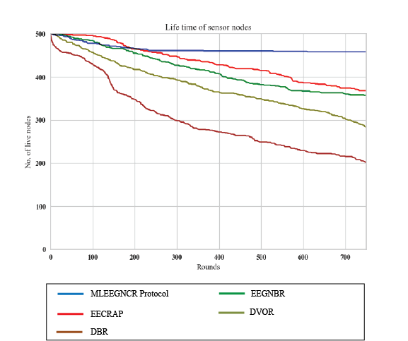
Performance Evaluation with existing Protocols
Protocol | Number of Dead Nodes | Residual Energy (in J) | Average E2E Delay (in s)
MCLBGNR | 42 | 6174.695326 | 0.786146338
EECRAP | 132 | 3726.321768 | 0.889010145
EEGNBR | 143 | 4171.564257 | 0.796901964
DVOR | 216 | 3687.166787 | 1.403363703
DBR | 311 | 1686.690131 | 0.747163901
Rounds: 750
Sinks: 9
Initial Energy: 15J

Slide 18
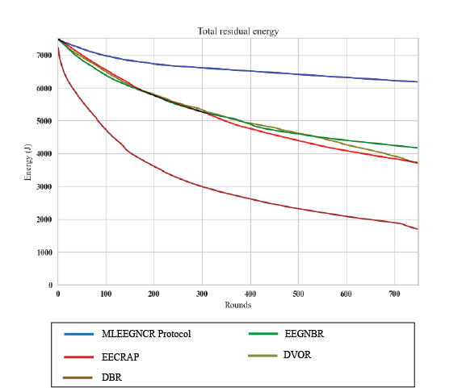
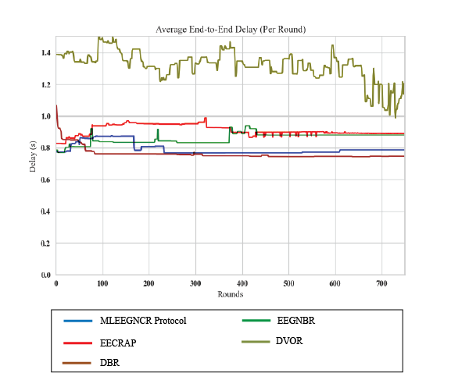
Performance Evaluation with existing Protocols

Slide 19
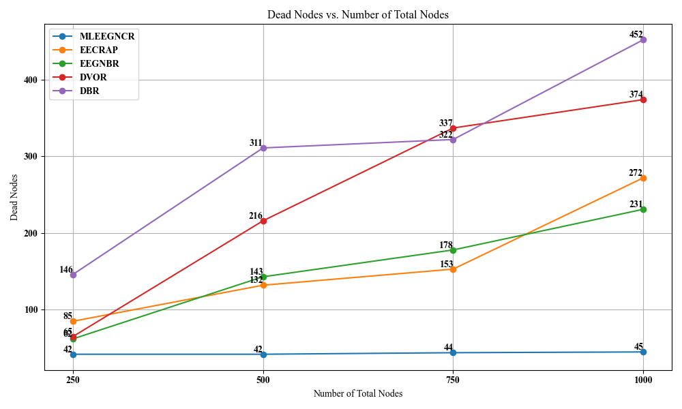
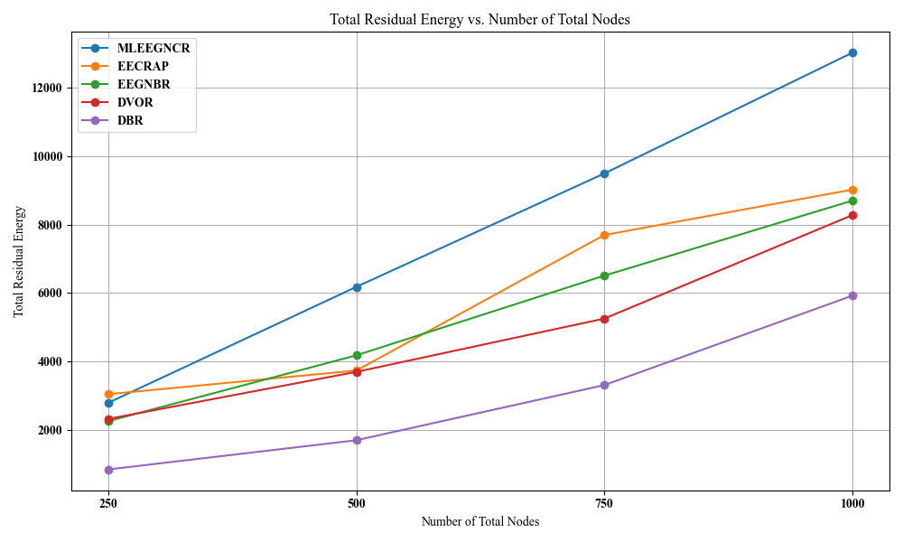
Performance Evaluation with existing protocols for different network sizes
Rounds: 750 Sinks: 9 Initial Energy: 15J

Slide 20
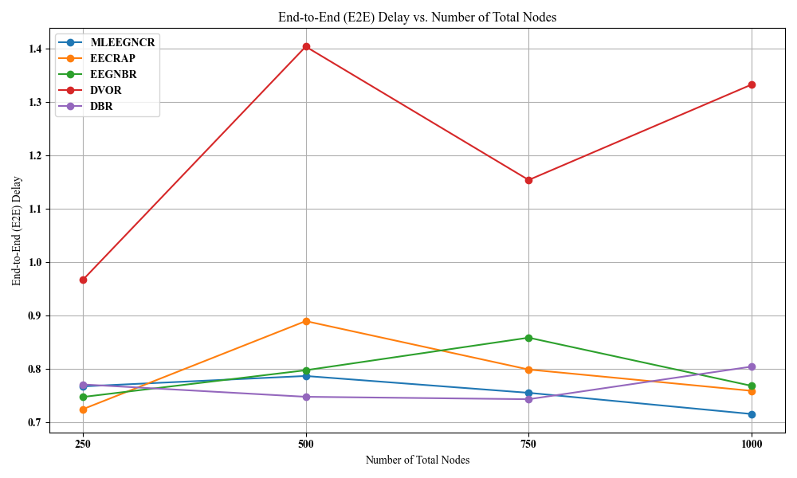
Performance Evaluation with existing protocols for different network sizes

Slide 21
Conclusion
Proposed MCLBGNR Protocol combines layer and sector division, with effective clustering and routing to handle void tolerance and increase network lifetime by a significant margin.
Layer Division increases network efficiency, and sector based clustering reduces network overhead.
Routing handles all CH location possibilities along with void handling.
Results comparing to other protocols show good performance in terms of number of dead nodes, residual energy and average end-to-end delay (per round).

Slide 22
Future Improvements:
Average E2E Delay is slightly higher for networks with lesser number of nodes, thus that can be improved.
Parameter optimisation for Evaluation Function(EF) and modified Evaluation Function(mEF) for maximum network performance.

Slide 23
References:
[1]: Yan, H., Shi, Z.J. and Cui, J.H., 2008. DBR: Depth-based routing for underwater sensor networks. In NETWORKING 2008 Ad Hoc and Sensor Networks, Wireless Networks, Next Generation Internet: 7th International IFIP-TC6 Networking Conference Singapore, May 5-9, 2008 Proceedings 7 (pp. 72-86). Springer Berlin Heidelberg.
[2]: Guan, Q., Ji, F., Liu, Y., Yu, H. and Chen, W., 2019. Distance-vector-based opportunistic routing for underwater acoustic sensor networks. IEEE Internet of Things Journal, 6(2), pp.3831-3839.
[3]: Zhu, J., Du, X., Han, D., Wang, L. and Li, M., 2019. LEER: Layer-based and energy-efficient routing protocol for underwater sensor networks. In Ad Hoc Networks: 11th EAI International Conference, ADHOCNETS 2019, Queenstown, New Zealand, November 18–21, 2019, Proceedings 11 (pp. 26-39). Springer International Publishing.
[4]: Han, D., Du, X. and Liu, X., 2020. CELR: Connectivity and energy aware layering routing protocol for UANs. IEEE Sensors Journal, 21(5), pp.7046-7057.
[5]: Khan, M.U., Otero, P. and Aamir, M., 2024. An Energy Efficient Clustering Routing Protocol based on Arithmetic Progression for Underwater Acoustic Sensor Networks. IEEE Sensors Journal.

Slide 24
THANK YOU

